Slide 1
Radiolink T8 RC Receiver
— Power
— Logic-Level Power
— PWM Output Signal
— PWM Input Signal
goBilda Dual Mode Servo Motor
KOVID KONSOLE PSoC
Control Circuitry
H-Bridge
DC Motor
LM7805 Linear Regulator
H-Bridge
DC Motor
LM7805 Linear Regulator
Buck Converter
Switched Capacitor Converter
Relay Control Circuit
DC Motor
12V Battery
Linear Actuator DC Motors
Relay Control Circuit

Slide 2







Two-Legged Mode
Three-Legged Mode
$$d$$
$$2α=36°$$
$$α$$
$\sqrt{l^{2}+d^{2}}$
$$l$$
$$α$$
$$2d$$

Slide 4
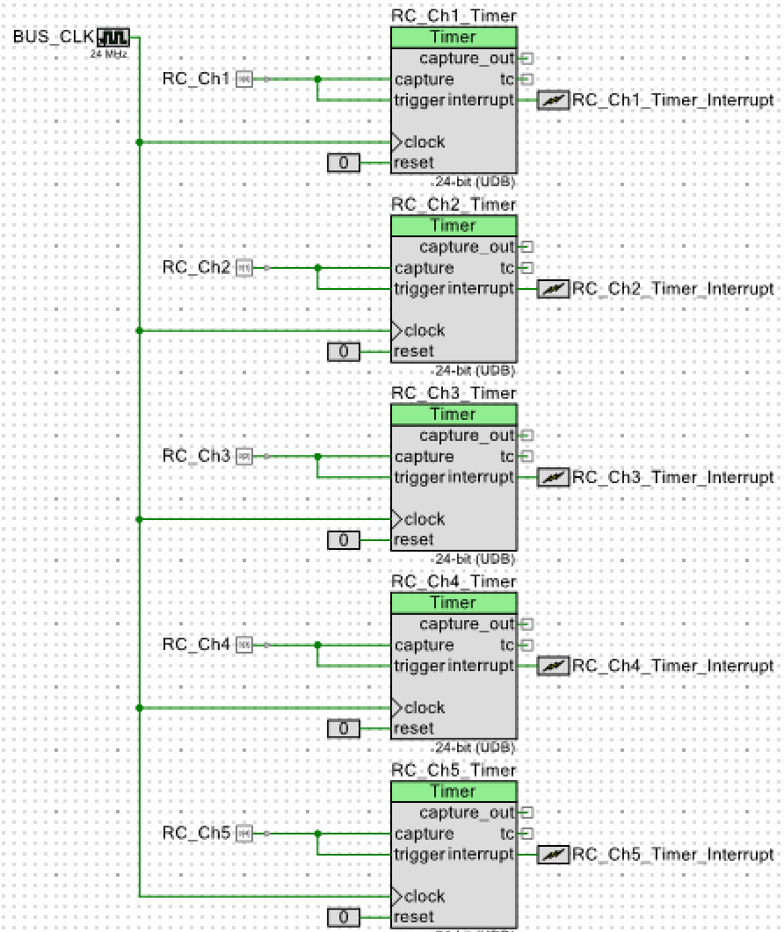
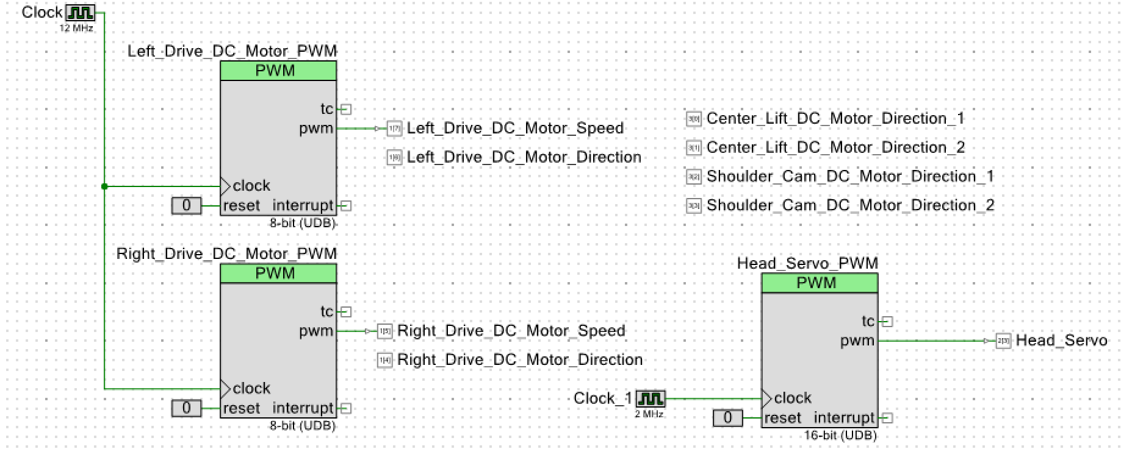
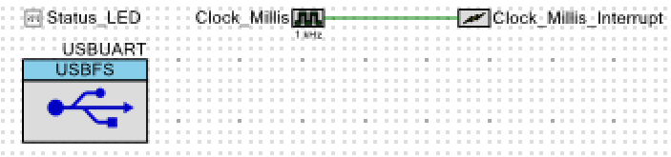

Slide 5
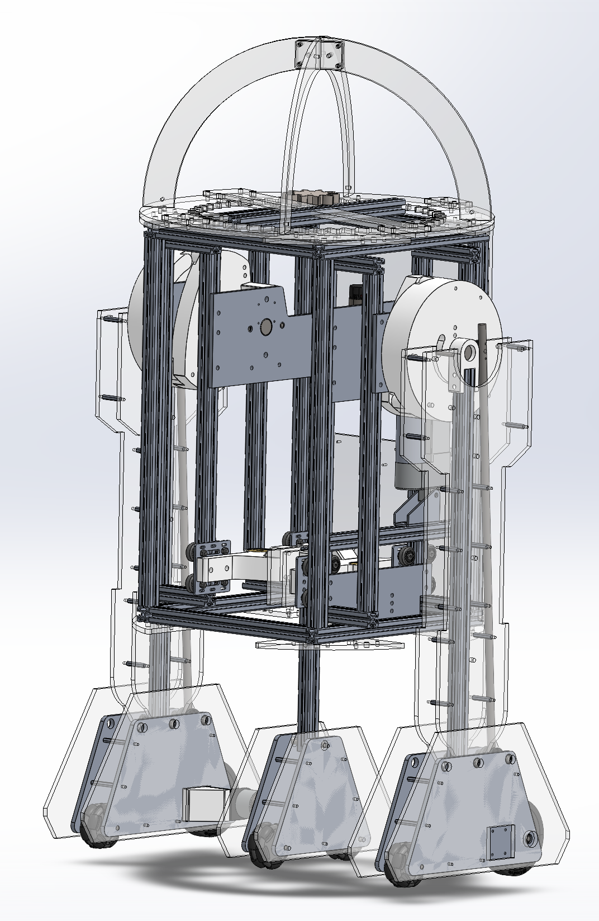
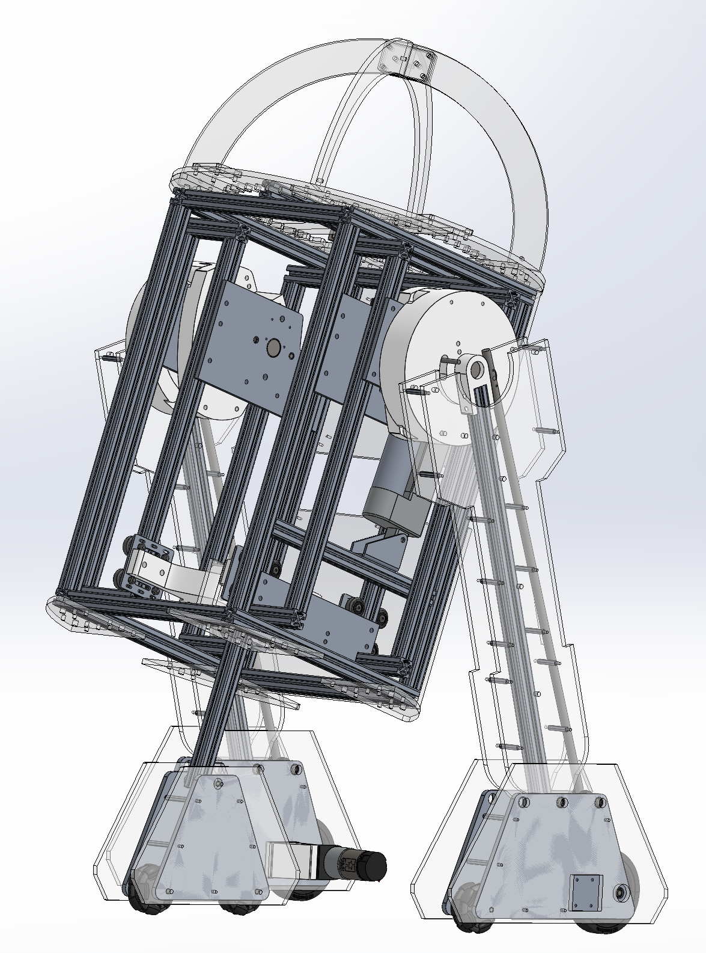

Slide 6
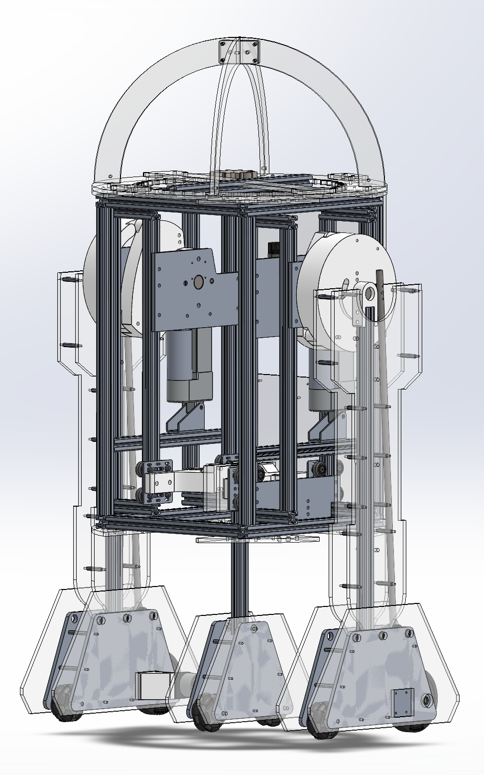
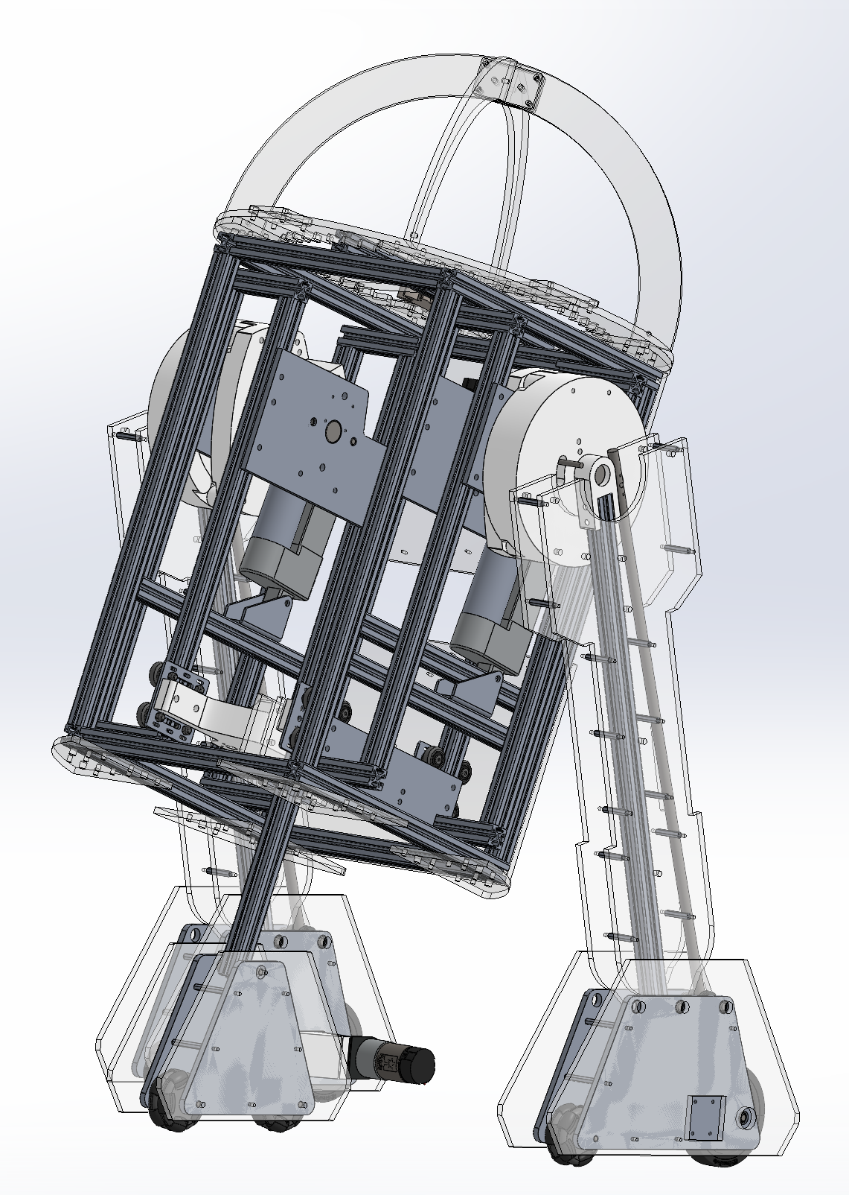

Slide 7
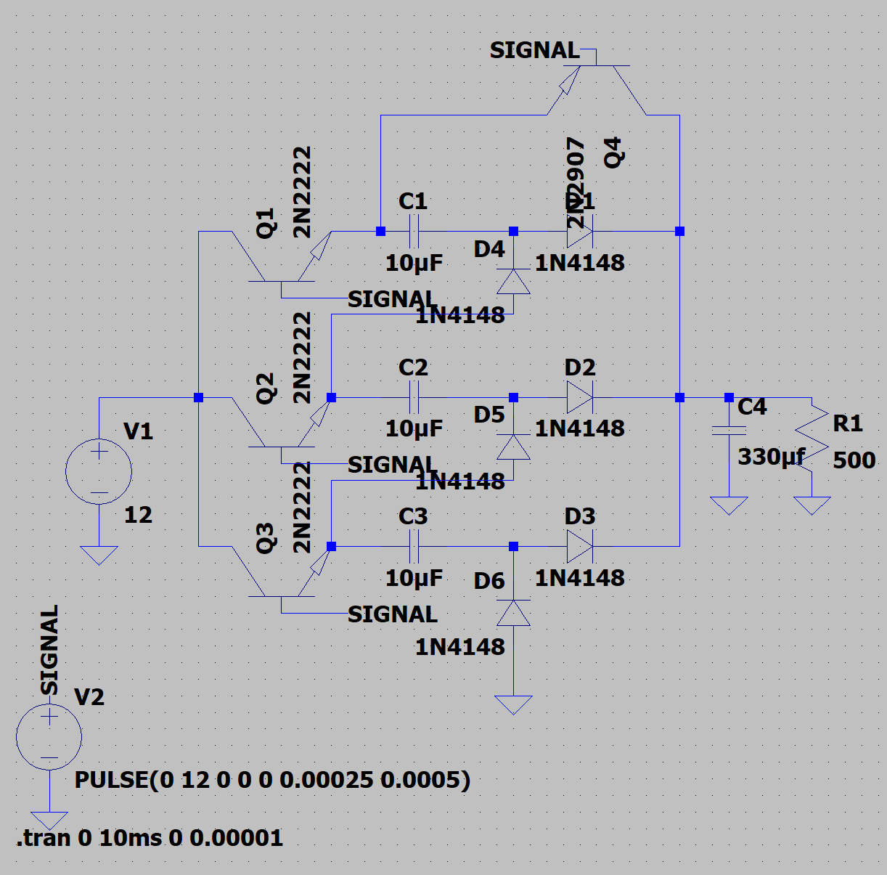
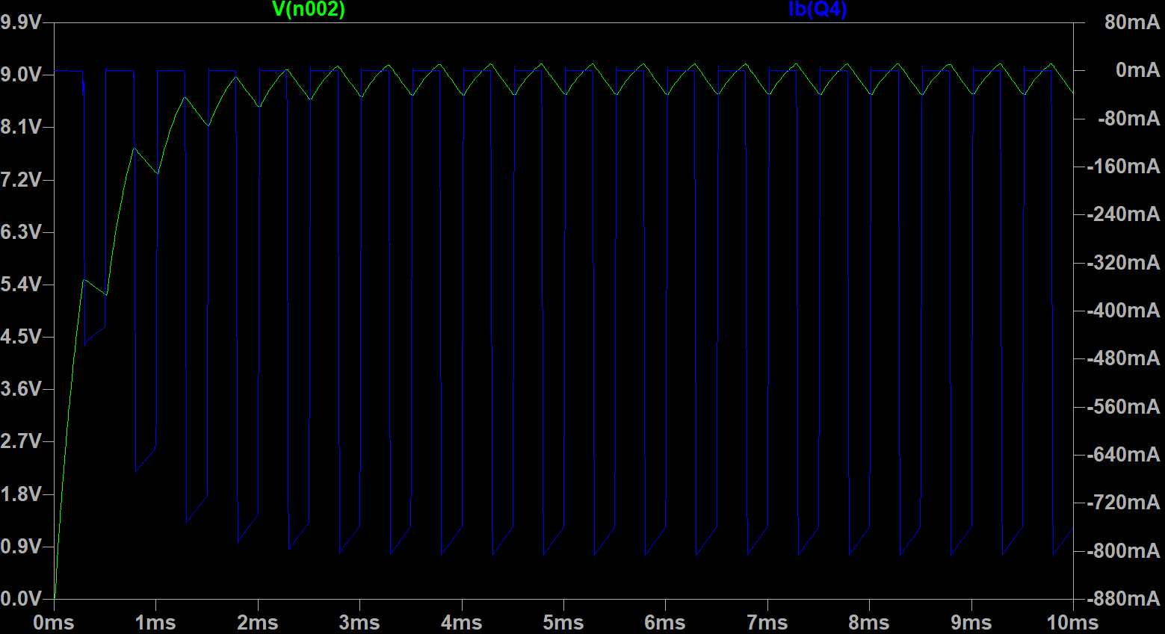

Slide 8
